Slide 1
👋
#thirtynine

Slide 2
How might we improve the lives of gig workers so that they are financially healthy and more resilient to financial shocks?
Bill & Melinda Gates Foundation

Slide 3
A gig is a single project or task for which a worker is hired, often through a digital marketplace, to work on demand.
US Bureau of Labor Statistics, 2016

Slide 4
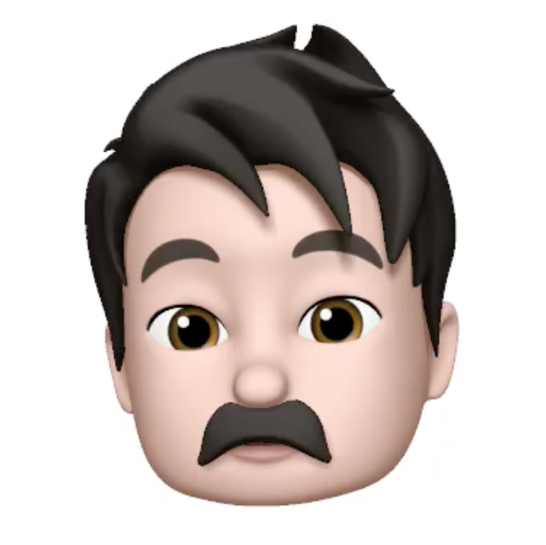

Pain Points
...
Low and Volatile Revenue
Long hours and significant amount of downtime
...
...

Slide 5
User driven Dashboard App for Gig Workers
We are providing a dynamic and transparent mobile platform that enables gig workers to monitor their markets, make smarter decisions and work more efficiently.

Slide 6
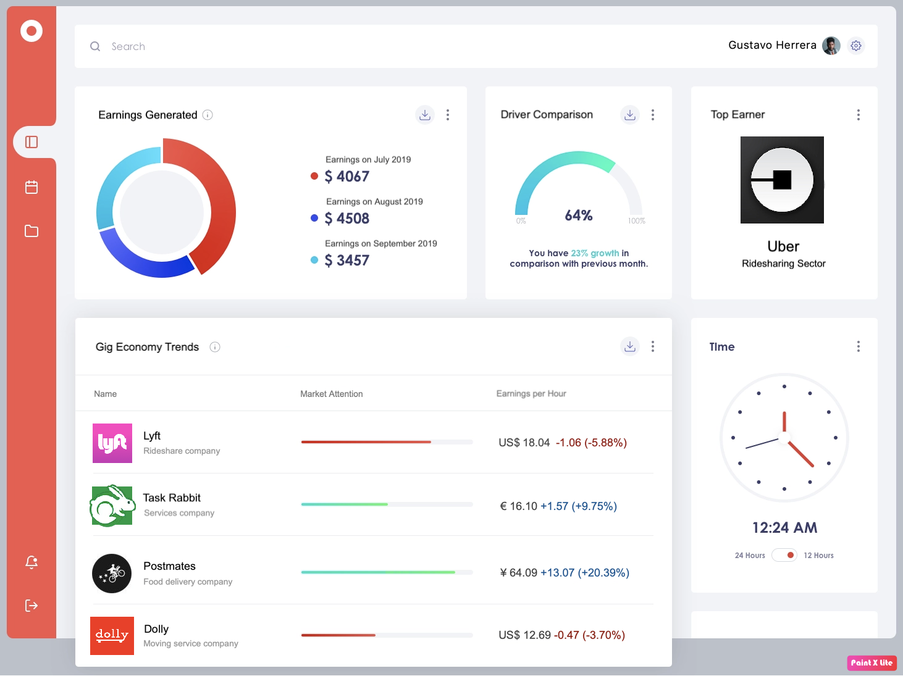
Solution

Slide 7
Demand
Supply
// Manually
// Glassdoor
// Online Forums (reddit)
// Glassdoor
// Indeed
// Stock Market App (Robin Hood)
// GigWalk

Slide 8
// Crowd sourced data
// Real time tracking
// Info sharing b/w users
Now
// Integrated solution tailored to
the needs of Gig Workers
Soon

Slide 9
Will People Use it?
// Enables information transparency between platforms
// Free and easy access

Slide 10
Configuration Most Likely to Succeed
// Dense urban area with many gig workers
_ Many types of gig platforms
// Workforce eager to communicate and make more money
// Access to digital devices and internet

Slide 11
Can we make it?

Slide 12
Hell Yeah! 💪

Slide 13
Thank You

